Slide 1
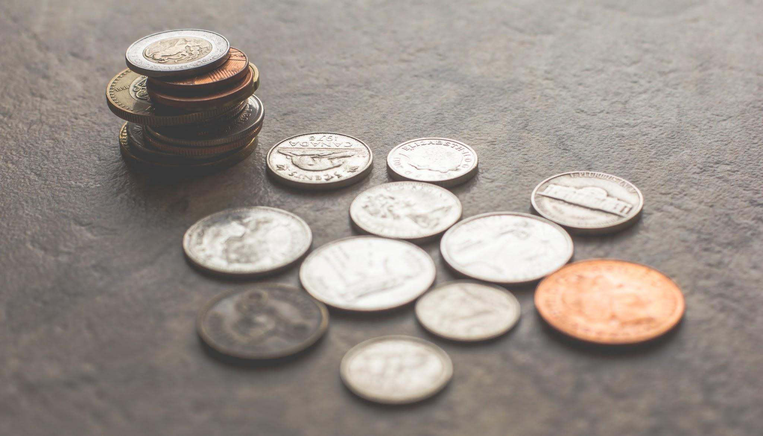
cv::findingCoins();
Ian Dudder & Karran Singh

Slide 2
Project Goals
Project Idea: Develop Coin Recognition Software
Objectives:
Recognize elliptical objects in a test image.
Determine which elliptical objects are coins and which are not.
Determine if the coin is heads up or tails up.
Determine the type of each coin (i.e. penny, nickel, dime, etc).
Report the value of the coins in the image as a collection.

Slide 3
Initial Methodology
Objective 1: Recognizing Ellipses
Perform edge detection on the image.
Use Hough’s Circle to identify circles.
Objective 2: Identify Coins in the image
Perform edge detection on each detected circle.
Count the number of edges in each circle. More edges indicates we have found a coin.
Objective 3: Determine if a coin is heads up or tails up.
Finding more edges indicates tails, fewer edges indicates heads.

Slide 4
Initial Methodology
Objective 4: Determine the type of coin
Compute a color histogram of each coin.
Based on color, determine if the coin is copper-colored or silver-colored.
Compare the coins to a template to distinguish between the silver coins.
Objective 5: Determine value of the coins.
Count up the number of each coin and compute the value of the collection as a whole.

Slide 5
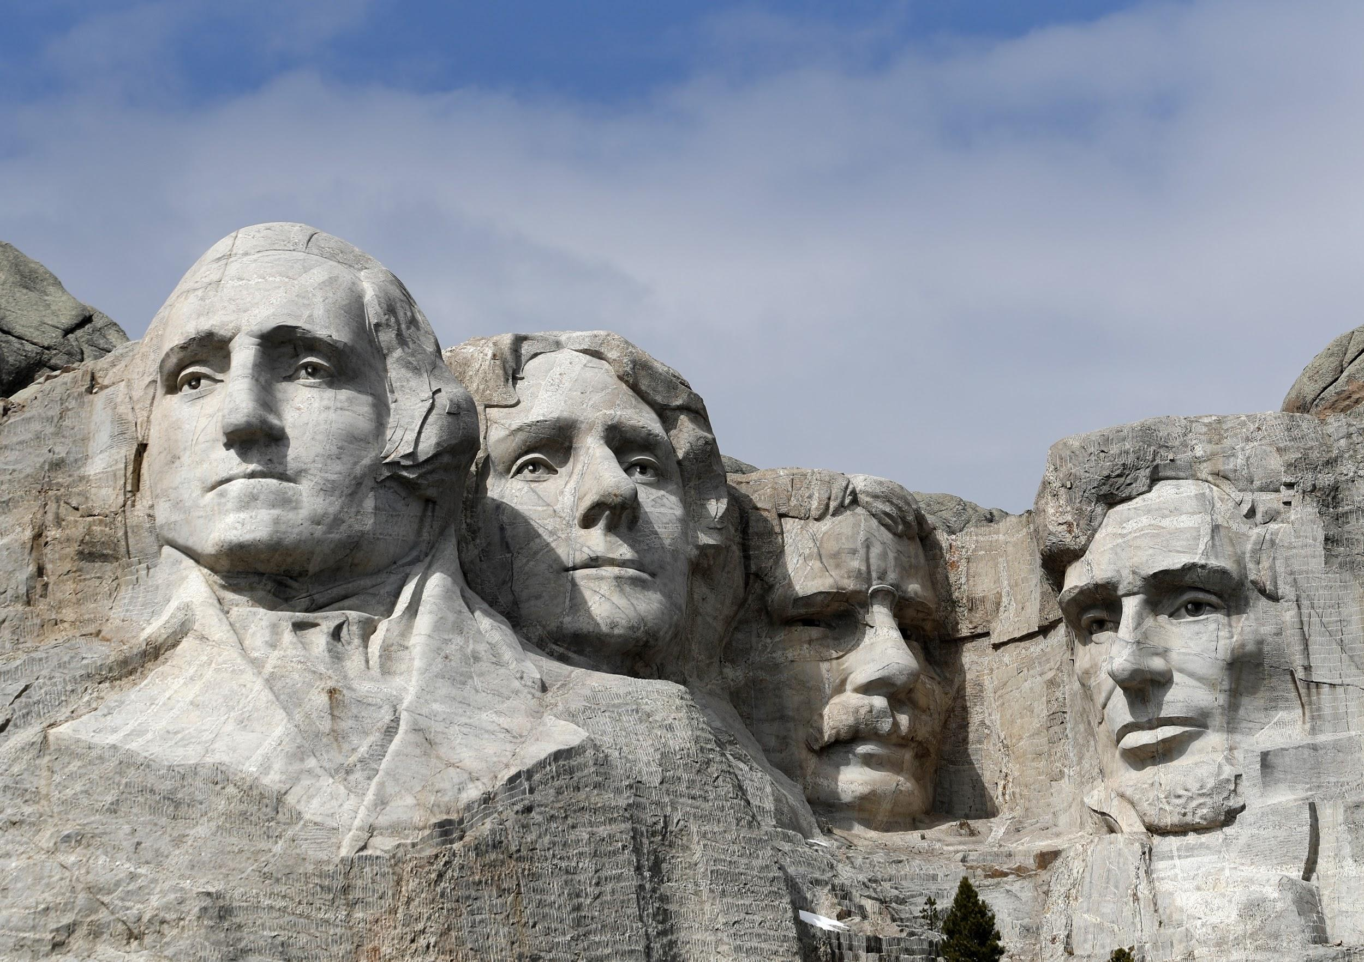
Obstacle 1
In reality, our initial methodology fell through.
Obstacle 1: Hough Circles was not precise enough
If the coins were at an angle, the circle was larger than the coin, leaving some of the background along with the coin.
It was difficult to compute a bounding rectangle from which to extract a sub-image from.
Notes:
In reality our initial plan of attack fell through.
The first problem we had was with hough circles.
Although this method worked pretty well for pictures taken from directly above the coins,
it did not work so well for pictures taken at an angle.
It was not precise enough and did not give us much information about the areas where the circles were found other than the center of the circle and its radius.

Slide 6
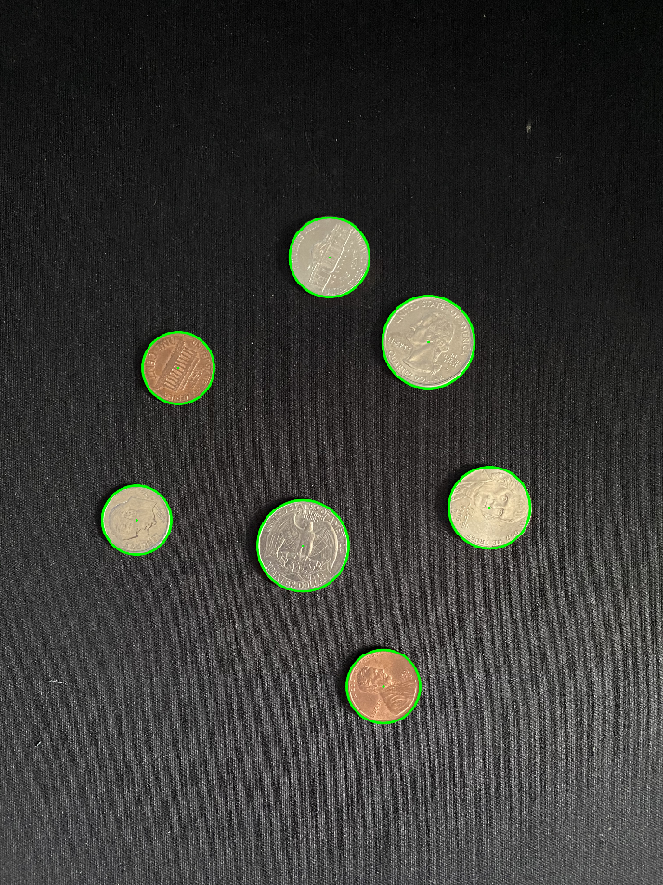
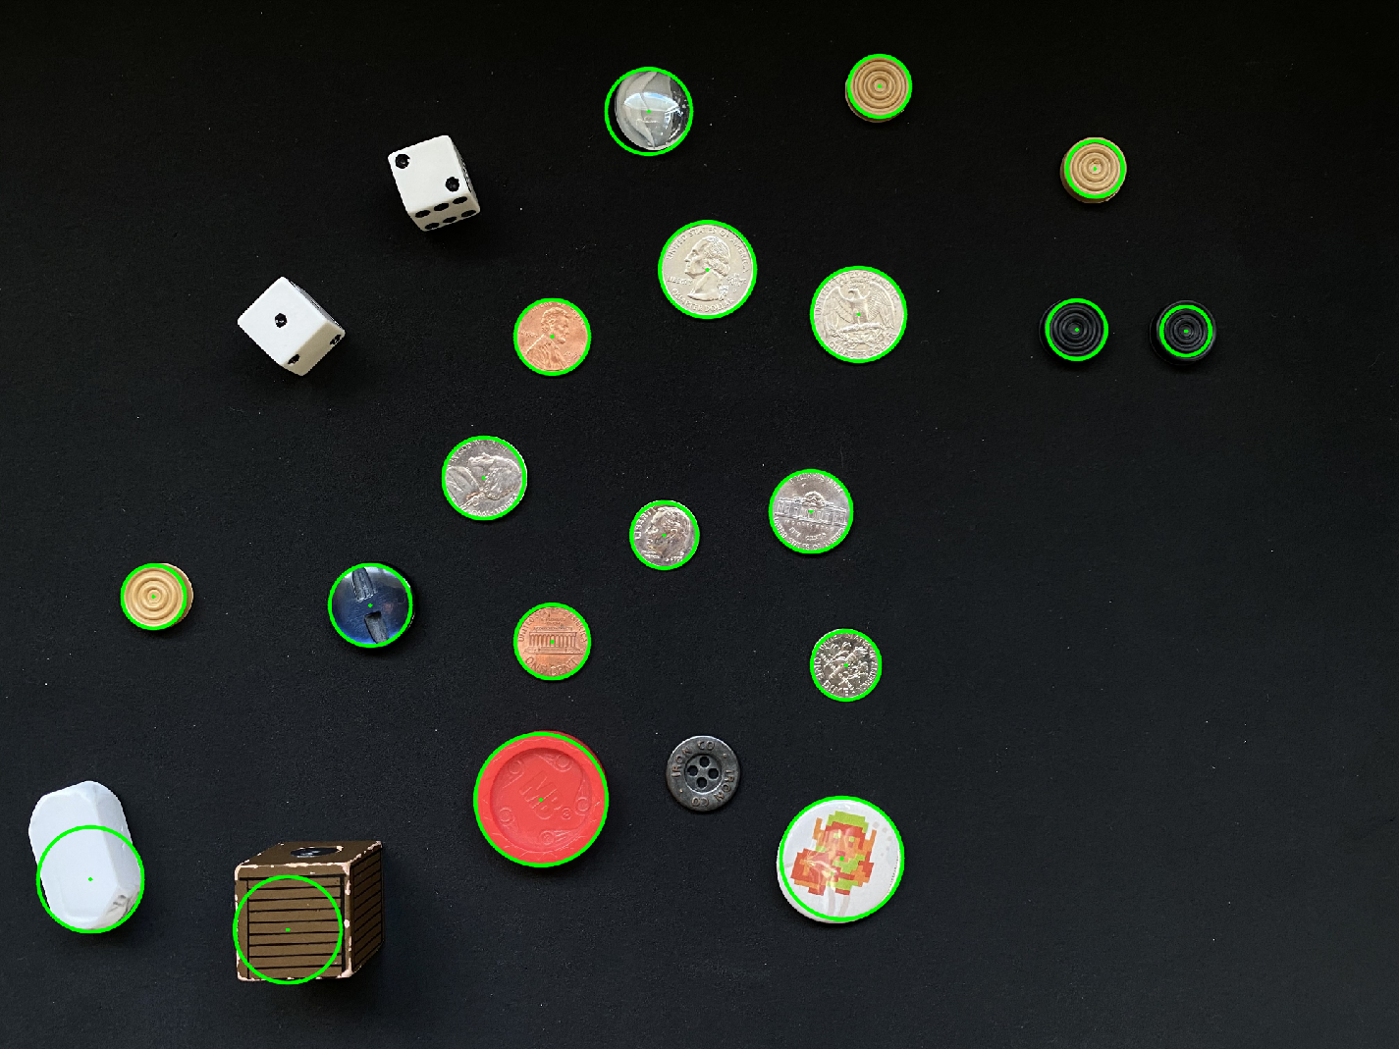
HoughCircles, mixed results
Notes:
Here is an example of hough circles at work.
You can see on the left image it did a pretty good job of finding all the coins.
But on the right image although it found all the coins, it also caught some unexpected objects such as the eraiser and the cube on the bottom left.

Slide 7
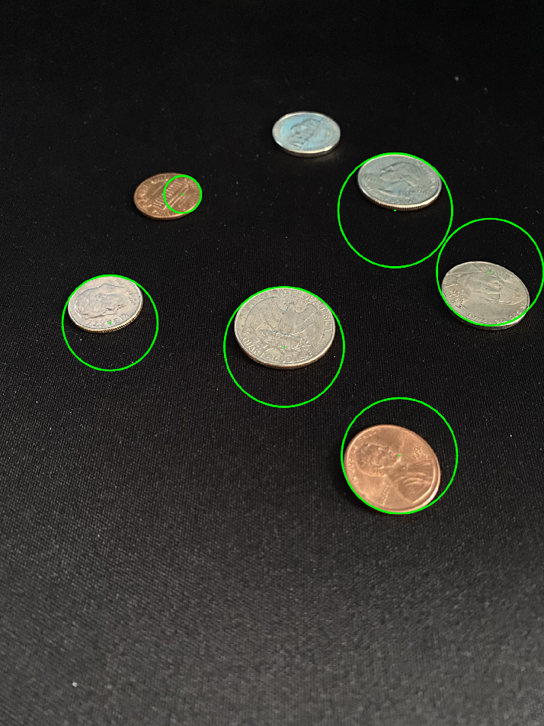
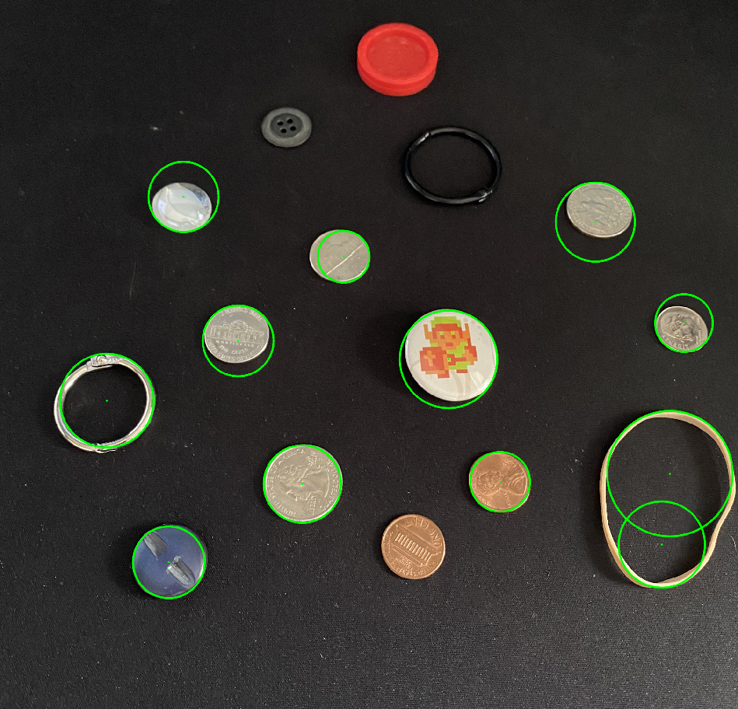
HoughCircles, poor results
Notes:
Here are a couple more images taken at a slightly greater angle.
You can see here hough circles did a much worse job with these. It missed some circles, over or under shot the ones it did find,
and even found some unexpected circles in the rubber band.
By now we had come to the conclusion that hough circles was not the right technique to find ellipses.

Slide 8
Revised Process
Use cv::findContours() for shape recognition rather than Hough Circles.
Provided us with exact locations and allowed us to create a bounding rectangle to extract a sub-image from.
Allowed us to create a best-fit ellipse that eliminated non-elliptical objects.
Notes:
While revising our approach at finding ellipses, we came across the find contours function available in openCV.
Find contours accepts a binary image and uses an algorithm to find shapes.
What we really liked about this approach was that there is a whole set of features in openCV which take a contour and can give you useful information like, the area of the contour,
And a minimum enclosing circle or ellipse which can be bound around the contour.
So we decided to try out this approach.

Slide 9
Challenges
Contours requires edges to connect in order to count as a shape.
In order to remove noise we needed to blur the image.
It quickly became a challenge to strike the right balance between eliminating noise while retaining enough edges.
Notes:
One of the first challenges we ran into while trying the find contours approach was that this method requires edges to connect in order to find a shape.
We began with giving it an edge image computed by blurings a grayscale copy of the source image and using canny to find the edges.
The problem was it quickly became a challenge to strike a balance between blurring enough times to eliminate noise in the image while still retaining enough edges in the coins.

Slide 10
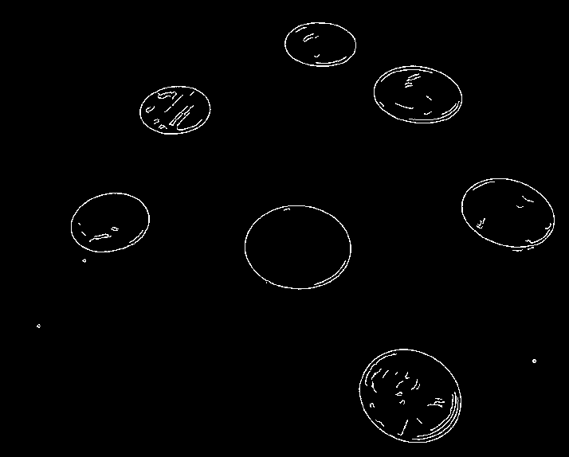
Finding contours with edge images using canny
Notes:
Here is an example of an edge image which was computed by using the canny function in openCV.
At this scale things look pretty good, but if we zoom in enough you can see not all the edges connect.

Slide 11
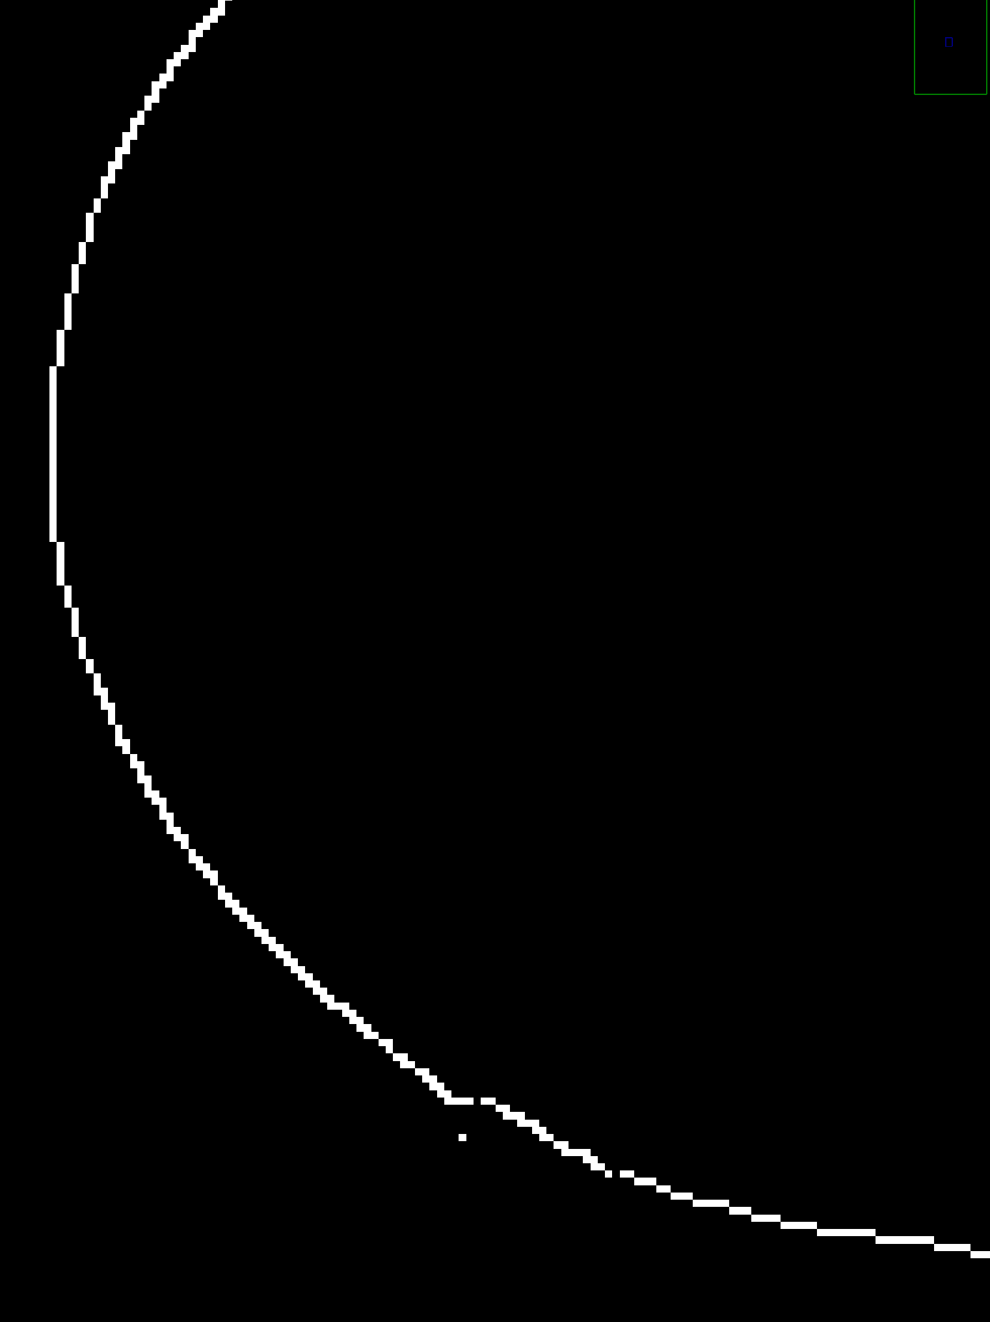

Broken
edges
Notes:
Here are two zoomed in images of different coins from the previous slide.
You can see on the left image the edge is broken by just one - two pixels in a few spots and on the right, there is a slightly bigger break.
Although some of these breaks were small, it was enough for find contours to not find these shapes.

Slide 12
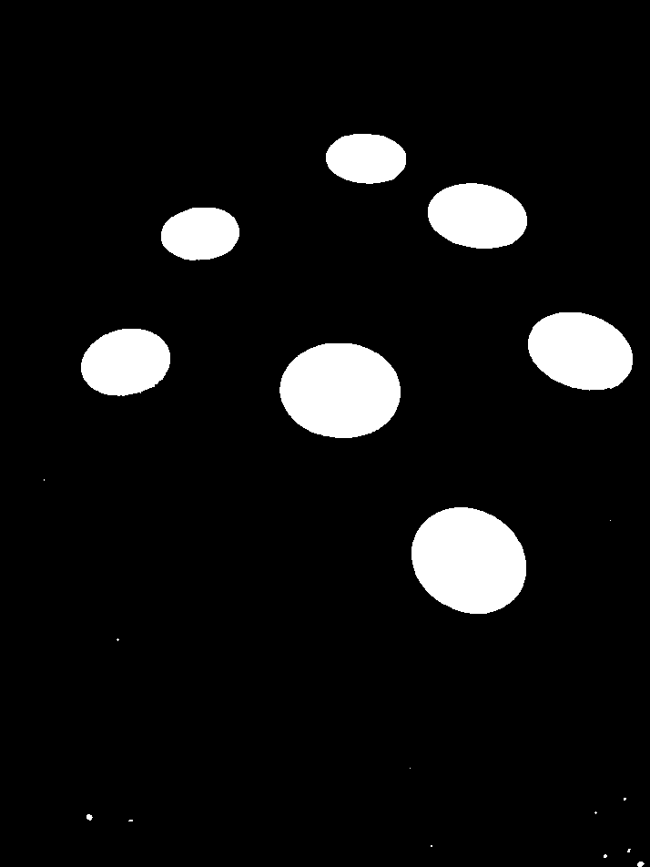
Finding contours with threshold images
Notes:
One of the other approaches we tried while struggling with the broken edges was to use the threshold feature to detect circles.
The Threshold function works by applying the same threshold value for every pixel,
If the pixel value is smaller than the threshold, it is set to 0, otherwise it is set to a maximum value.
And since threshold outputs a binary image, this worked in the findcontours function
and we had some success.

Slide 13
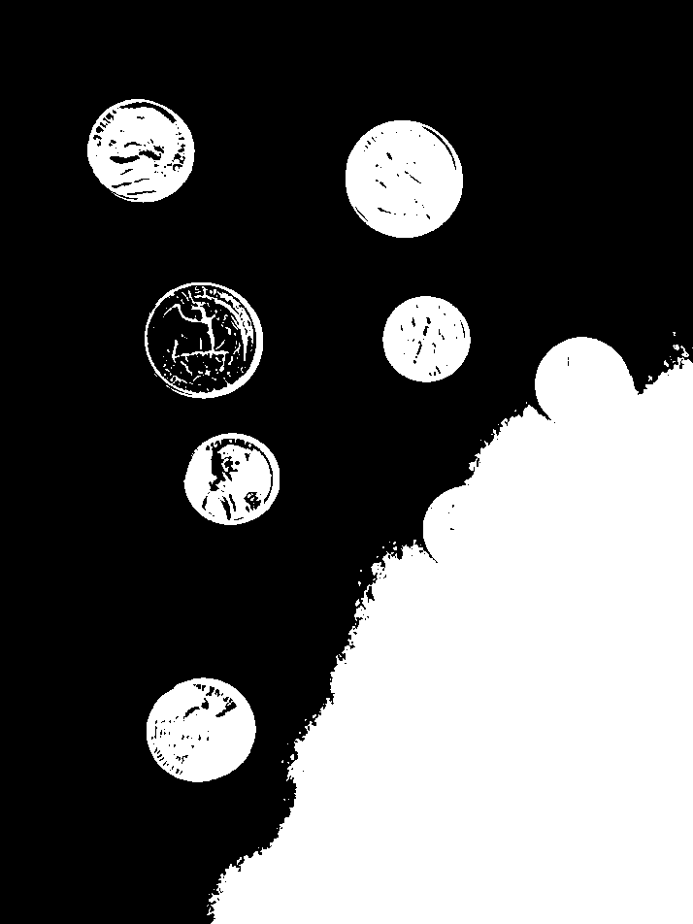
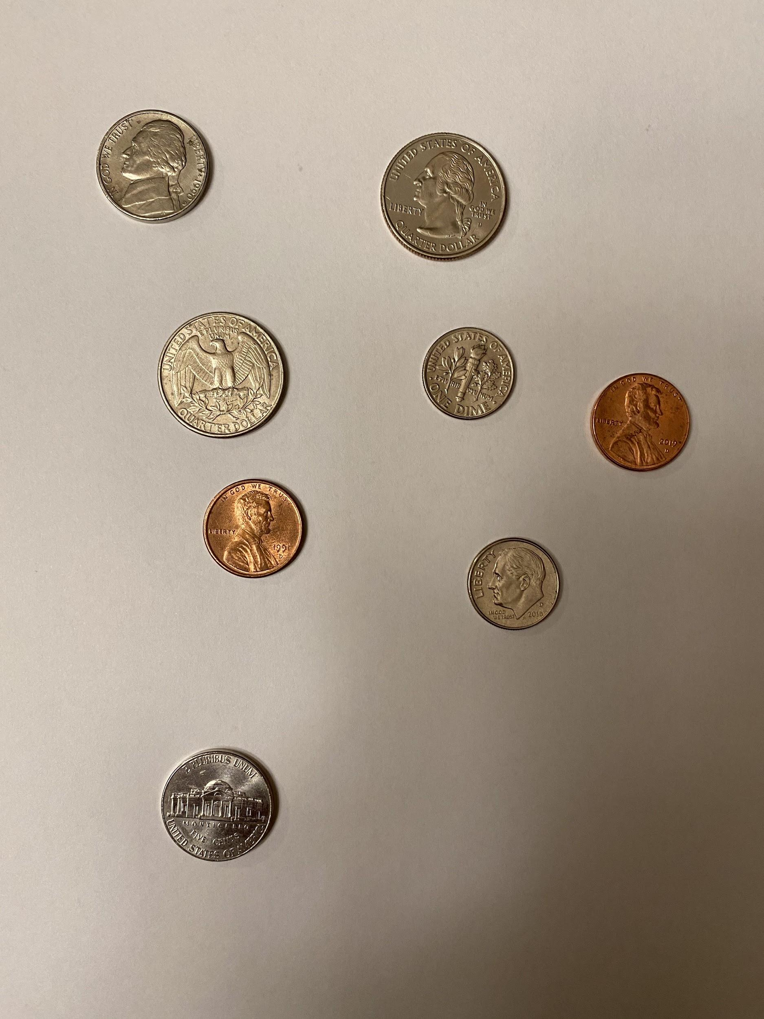
Threshold with some shadows
Notes:
But soon after we realized there was a problem with this approach.
You can see in this image
Taking the threshold of an image with slight shadows would give us unusable results.
We found this problem hard to combat with many of our images

Slide 14
Back to canny
Notes:
So we went back to the canny approach.
While researching openCV documentation, we came across the dilate function.
The dilate function takes in an image, convolves it with a kernel and expands shapes contained in the input image.

Slide 15


cv::dilate
Notes:
Here are the results of the same image as the previous slide
with just a single iteration of the dilate function applied to it.
You can see here that there are no longer broken edges.

Slide 16
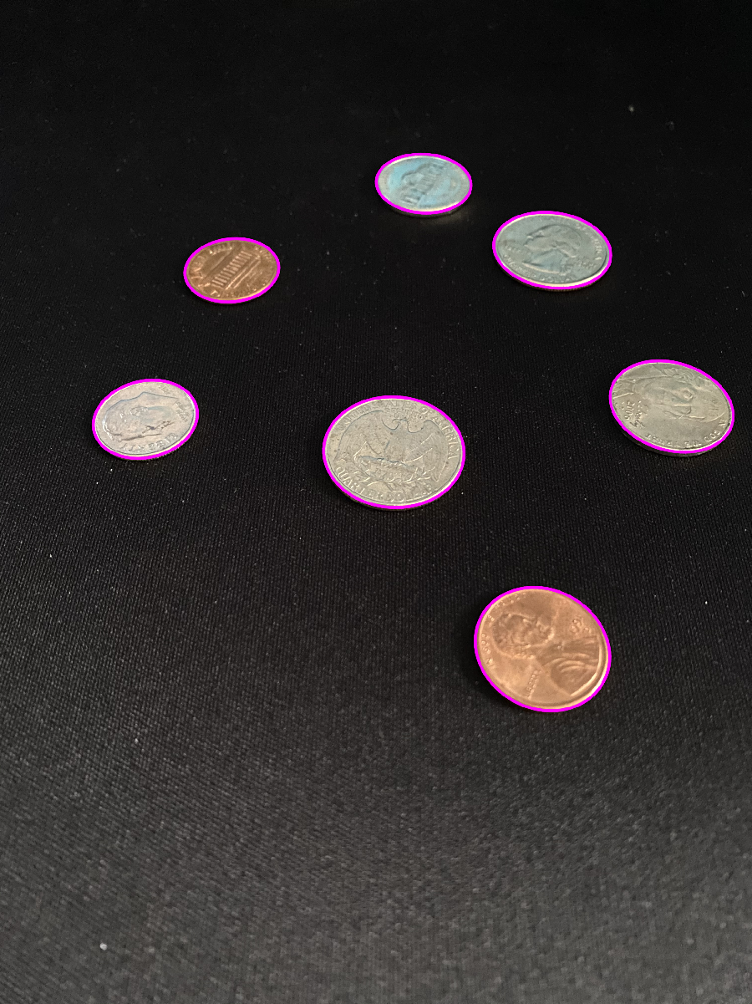
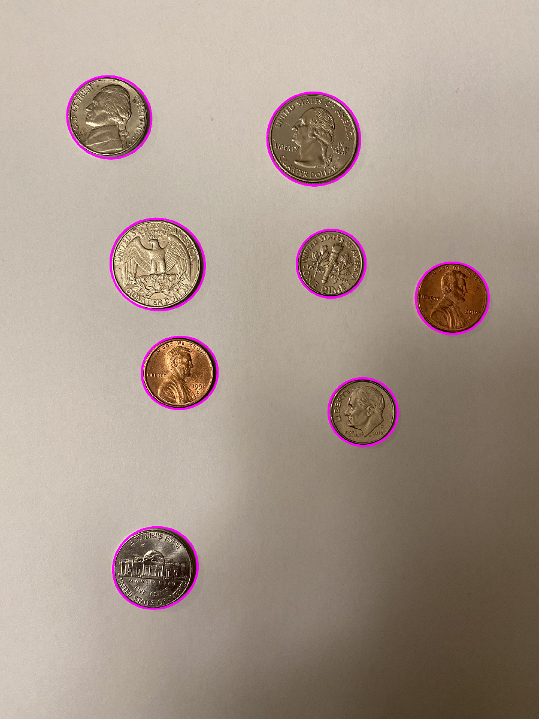
Good results with dilation
Notes:
So after trying various kernel sizes and iterations using the dilate function on the canny image
We were successfully able to consistently find most shapes of interest in an image.
In these images you can see all the contours of interest were found and enclosed by a pink circle.

Slide 17
Obstacle 2
Obstacle 2: Sheer count of edges was not enough to determine if a circle was a coin or not, nor was it able to determine if a coin was heads up or tails up.
More information was needed.

Slide 18
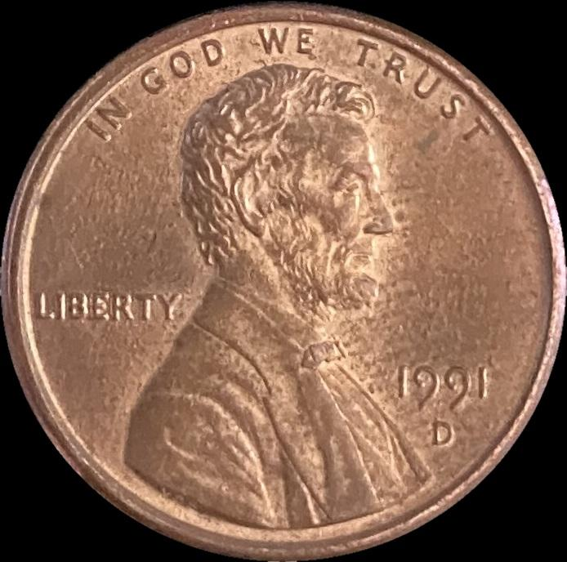
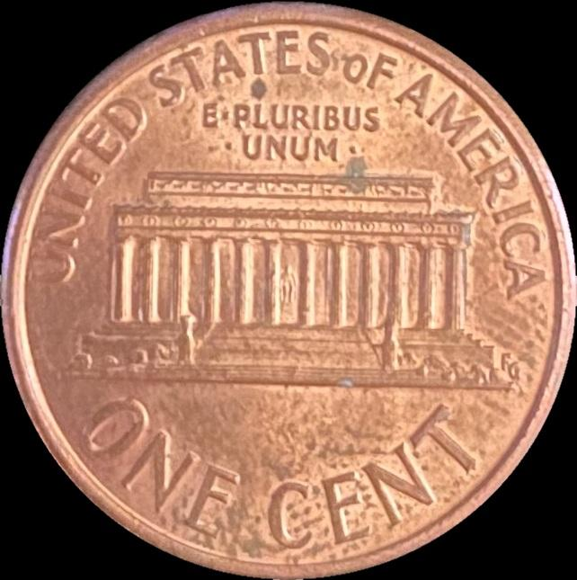
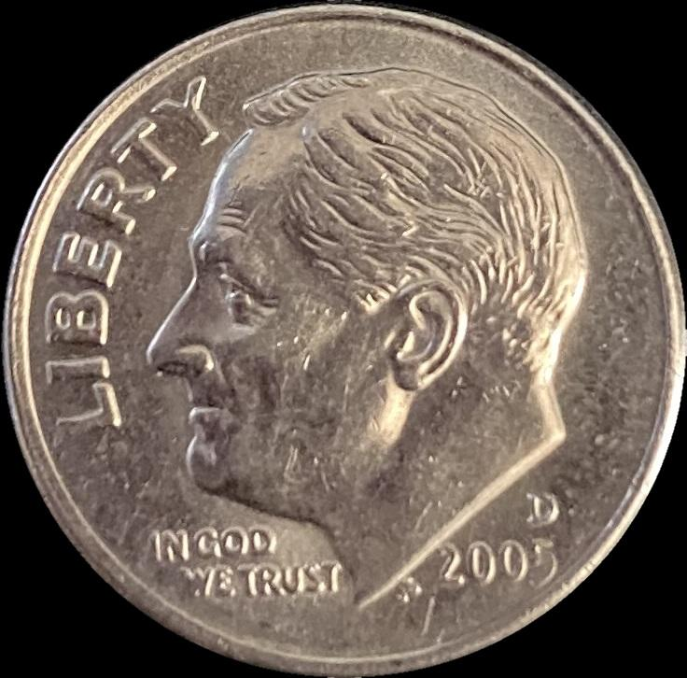
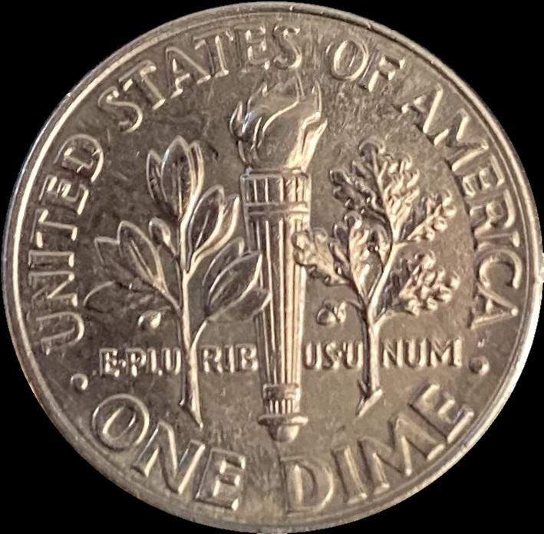
Template Matching
Use template matching to determine if an ellipse is a coin.
Scale down template to be the same size as the patch.
Rotate the image until a best match is found.
Compare matches to one-another for best match.
Compute percentage of matched edges and threshold it to eliminate objects that are not coins.

Slide 19
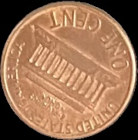
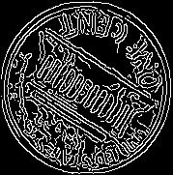
Template Matching
Steps
1. Create a sub-image (patch) for each contour found.
2. Compute the edge image of the patch.
Patch
Edge Image

Slide 20
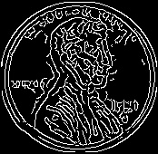
Template Matching
3. Compare the patch’s edges to a template. Scale down the template to be the same size. Try every rotation of the template and keep track of matched edges.
Patch
Rotating Template

Slide 21

Template Matching
4. Remember which rotation and template coin gave us the best match.
Patch
Rotating Template

Slide 22
Results
By remembering the number of edges that match, we can determine if the ellipse is a coin.
Coins will match ~50% of their edges with the templates. Objects that are not coins will have less than 50% of their edges match.
Another useful tactic: compute the ratio of edges to non-edges for an object. Coins have ~14% of their total patch-space as edges. Smoother non-coin objects have less.
Despite keeping track of the best matches for every rotation of every coin, template matching cannot tell us what type of coin it is.

Slide 23
Obstacle 3
Color is unreliable.
The color comparison used to distinguish between copper and silver-colored coins is not fine-tuned yet.
This gave us significant challenges due to the heavy variation of color between images.
Computing color histograms and finding the most common colors in the coins was ineffective even with large ranges of buckets allowed.

Slide 24
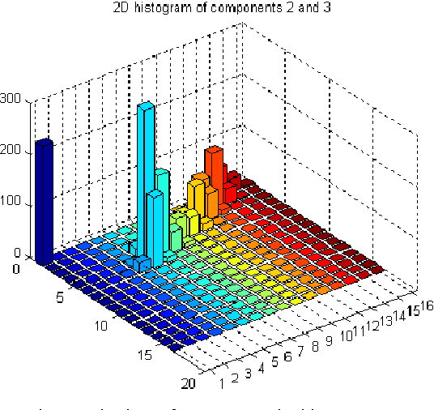
Obstacle 3
BucketSize = 4; Penny BGR = 160, 160, 224 Nickel BGR = 224, 224, 224 Quarter BGR = 160, 160, 160
BucketSize = 8; Penny BGR = 176, 208, 240 Nickel BGR = 240, 240, 240 Quarter BGR = 140, 140, 140
Color Histogram Example
Notes:
Here is the most common color for our template image given different bucket sizes

Slide 25
Obstacle 3
BucketSize = 16; Penny BGR = 168, 200, 232 Nickel BGR = 232, 232, 232 Quarter BGR = 152, 152, 152
BucketSize = 32; Penny BGR = 164, 188, 228 Nickel BGR = 228, 228, 228 Quarter BGR = 140, 148, 148
Color Histogram Example
Notes:
Pennies matched closer to quarters, dimes matched closer to pennies, etc.

Slide 26
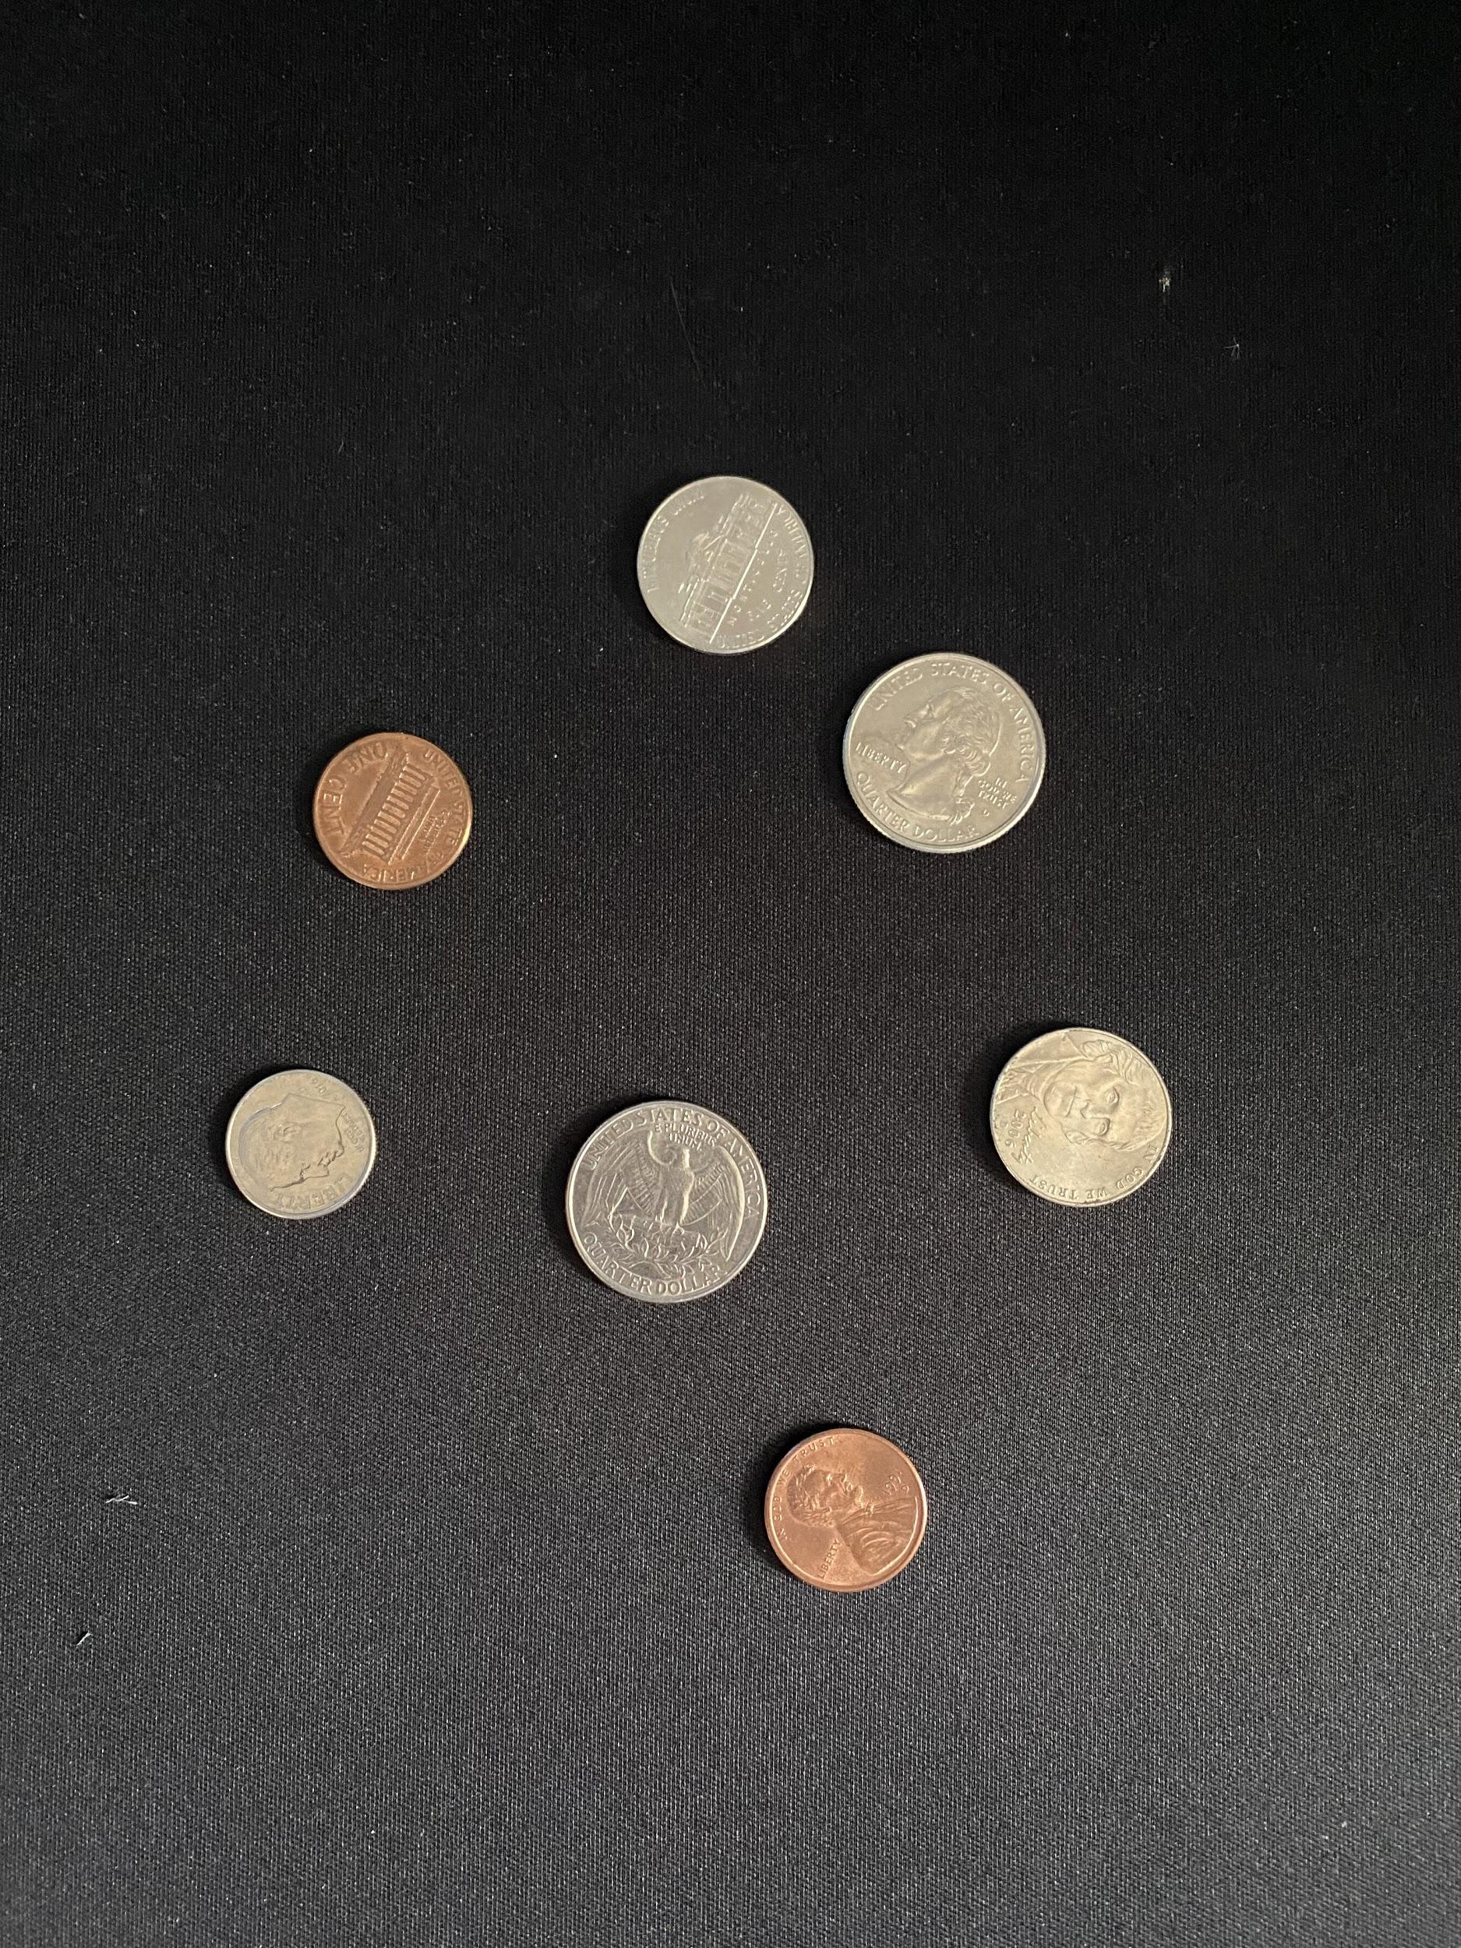
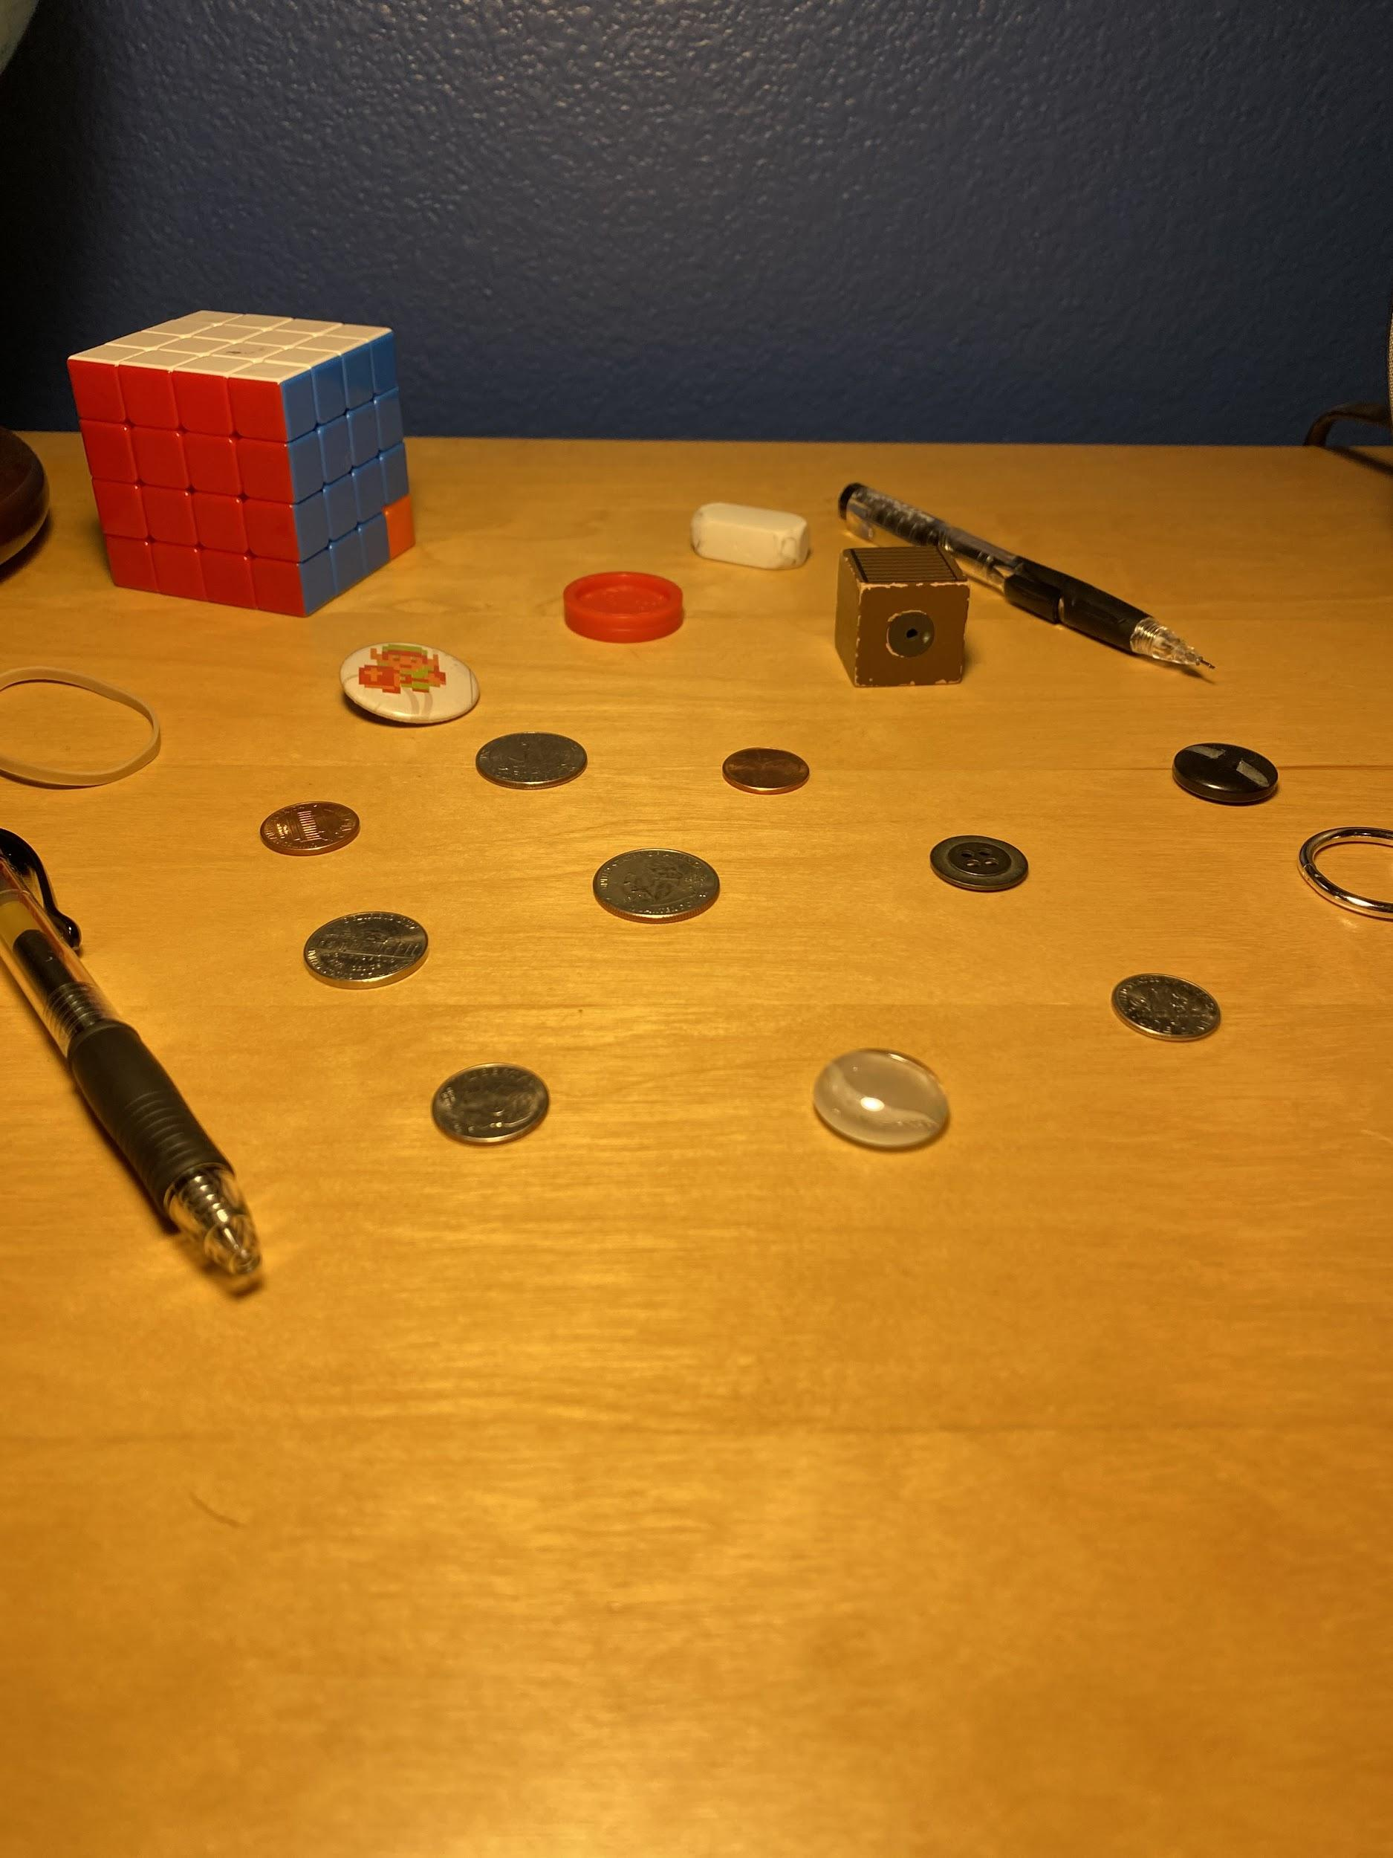
Obstacle 3
Notes:
Very different color. Very different results

Slide 27

Project Results
Completed Objectives 1 and 2.
Made progress on objectives 3 and 4, but neither is fine-tuned enough to be accurate yet.
Notes:
Project results
So far, we’ve completed objectives 1 and 2
And made progress on objectives 3 and 4
But neither of the latter are fine-tunes enough to be accurate yet.

Slide 28
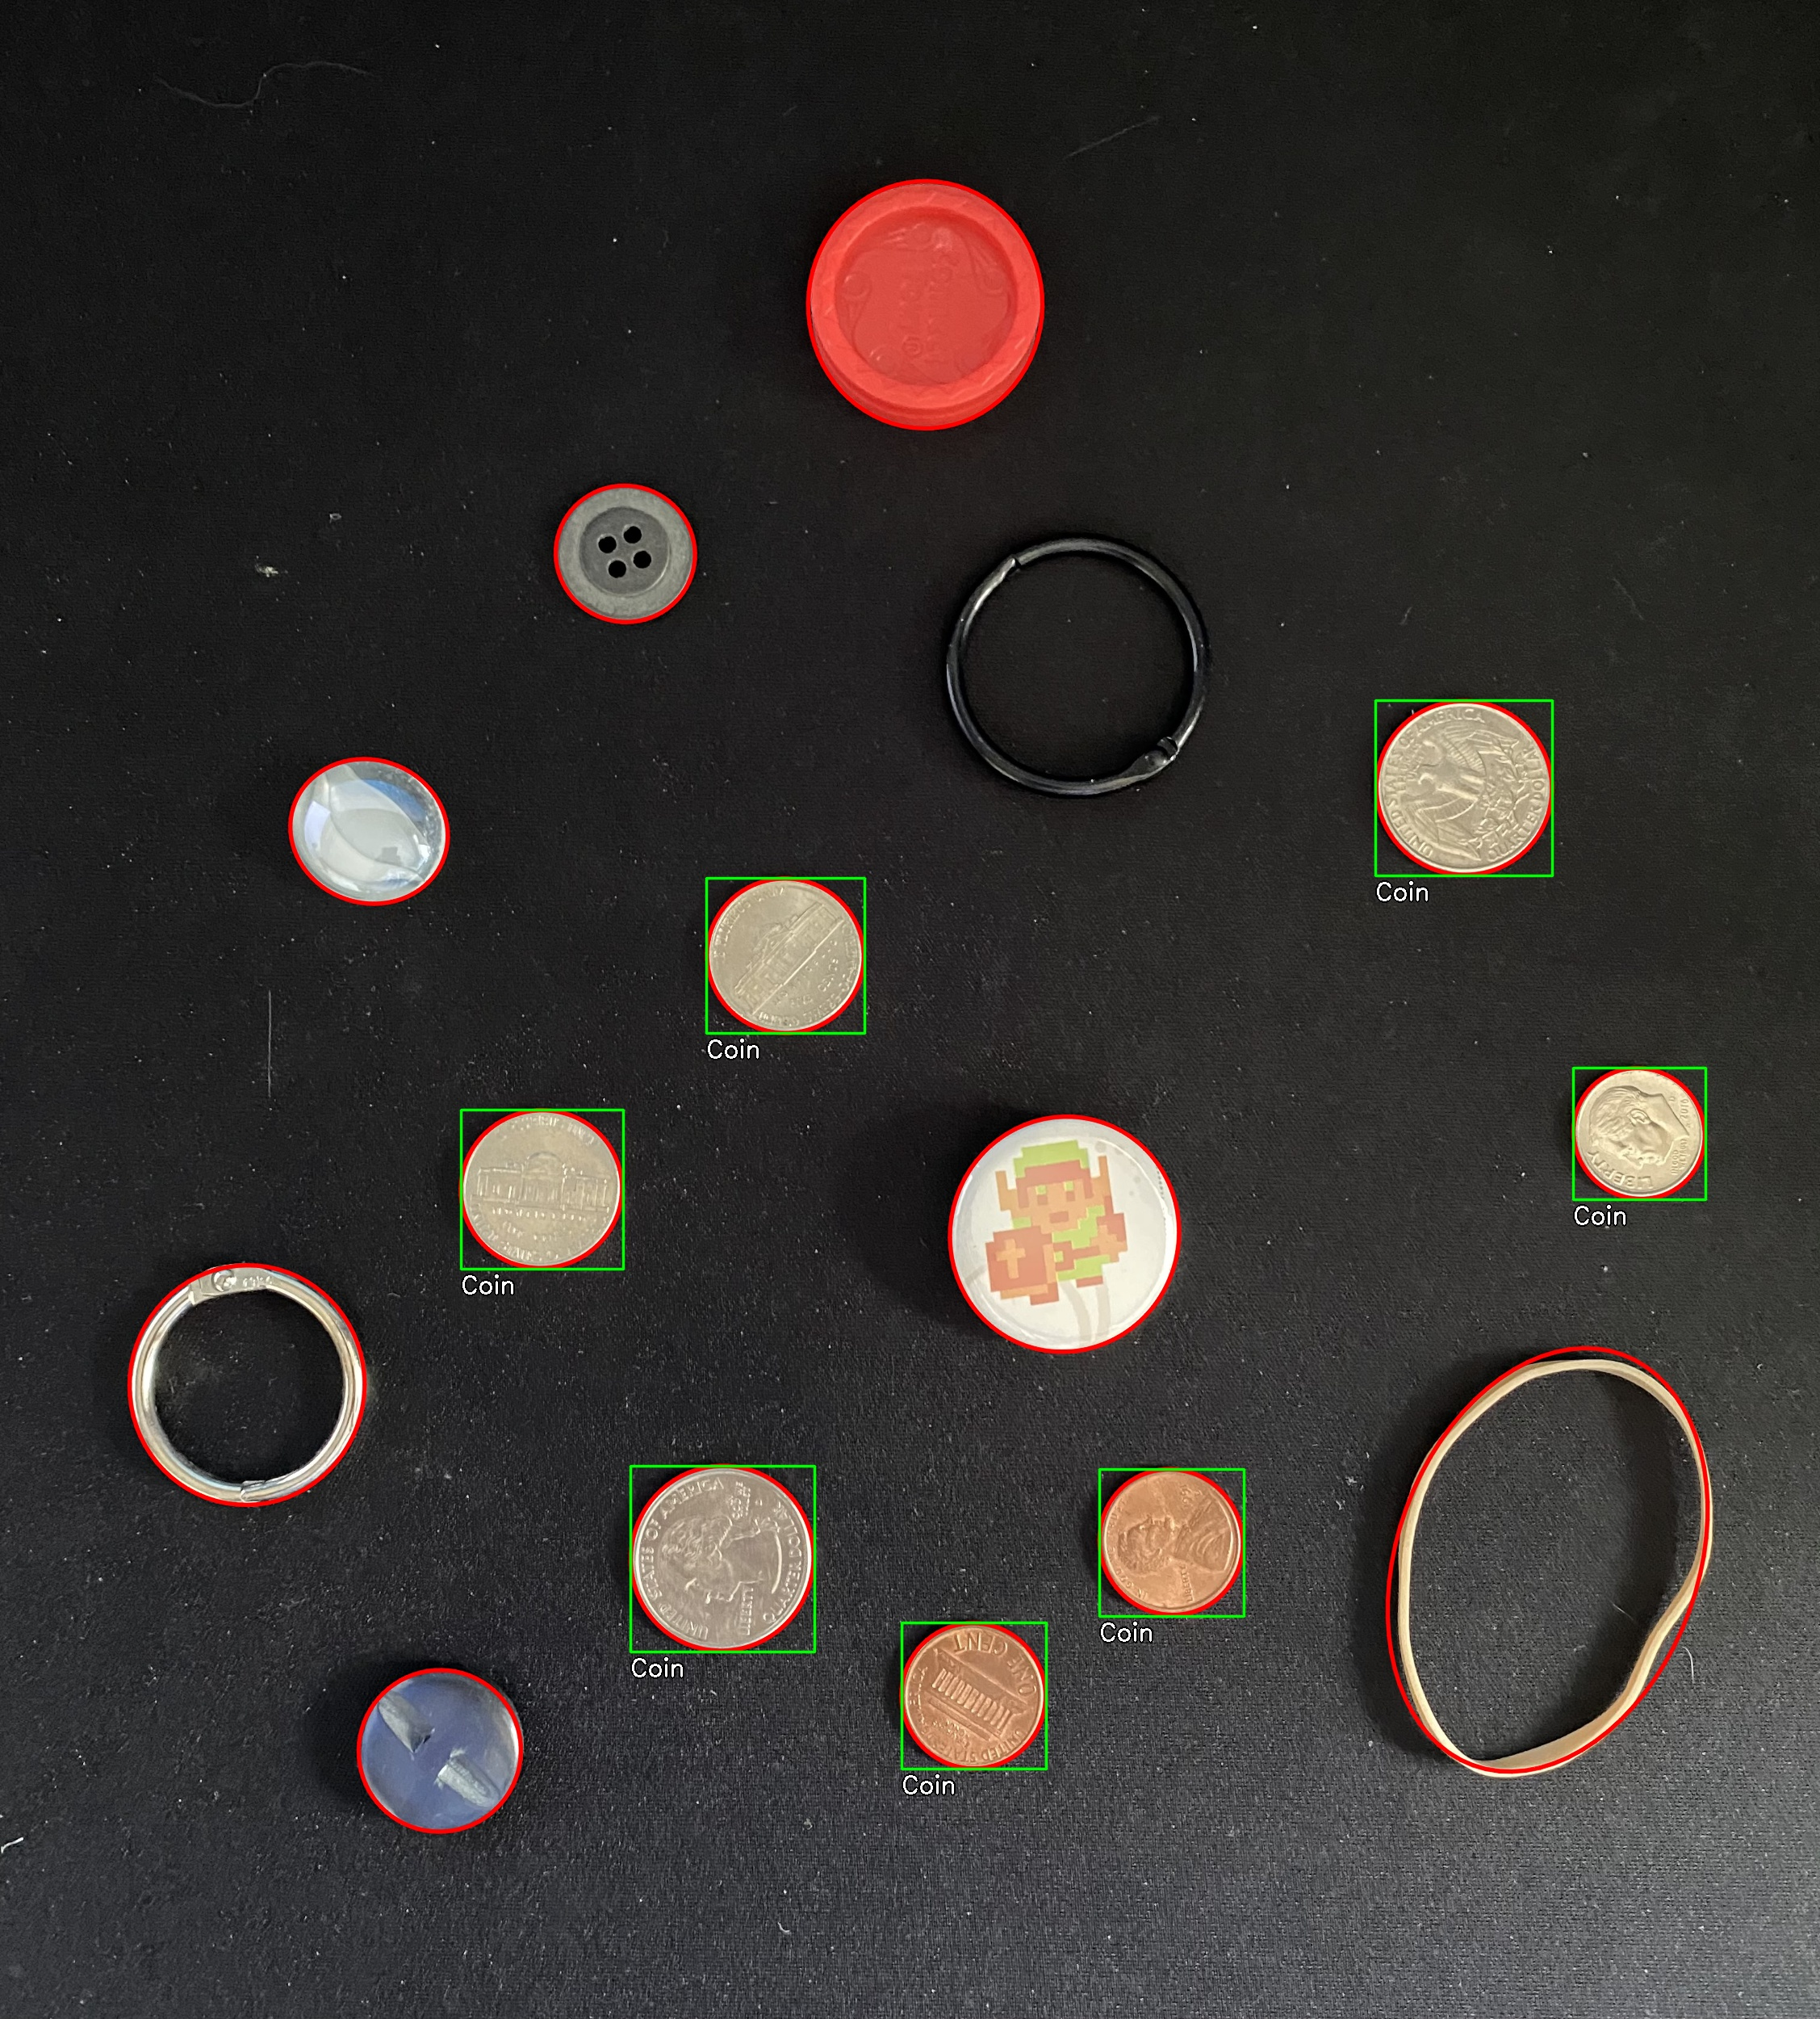
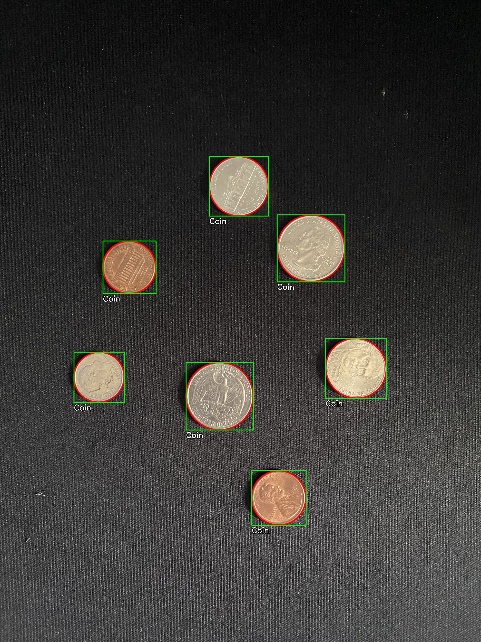
Success Images
Notes:
Here you can see some success images.
The contours have their best-fit ellipse drawn in red.
On the left image, nearly every shape was found, except for the black binder ring.
And of all the shapes found, we were correctly able to identify the coins.
Which are shown enclosed in a green square, along with an annotation.

Slide 29
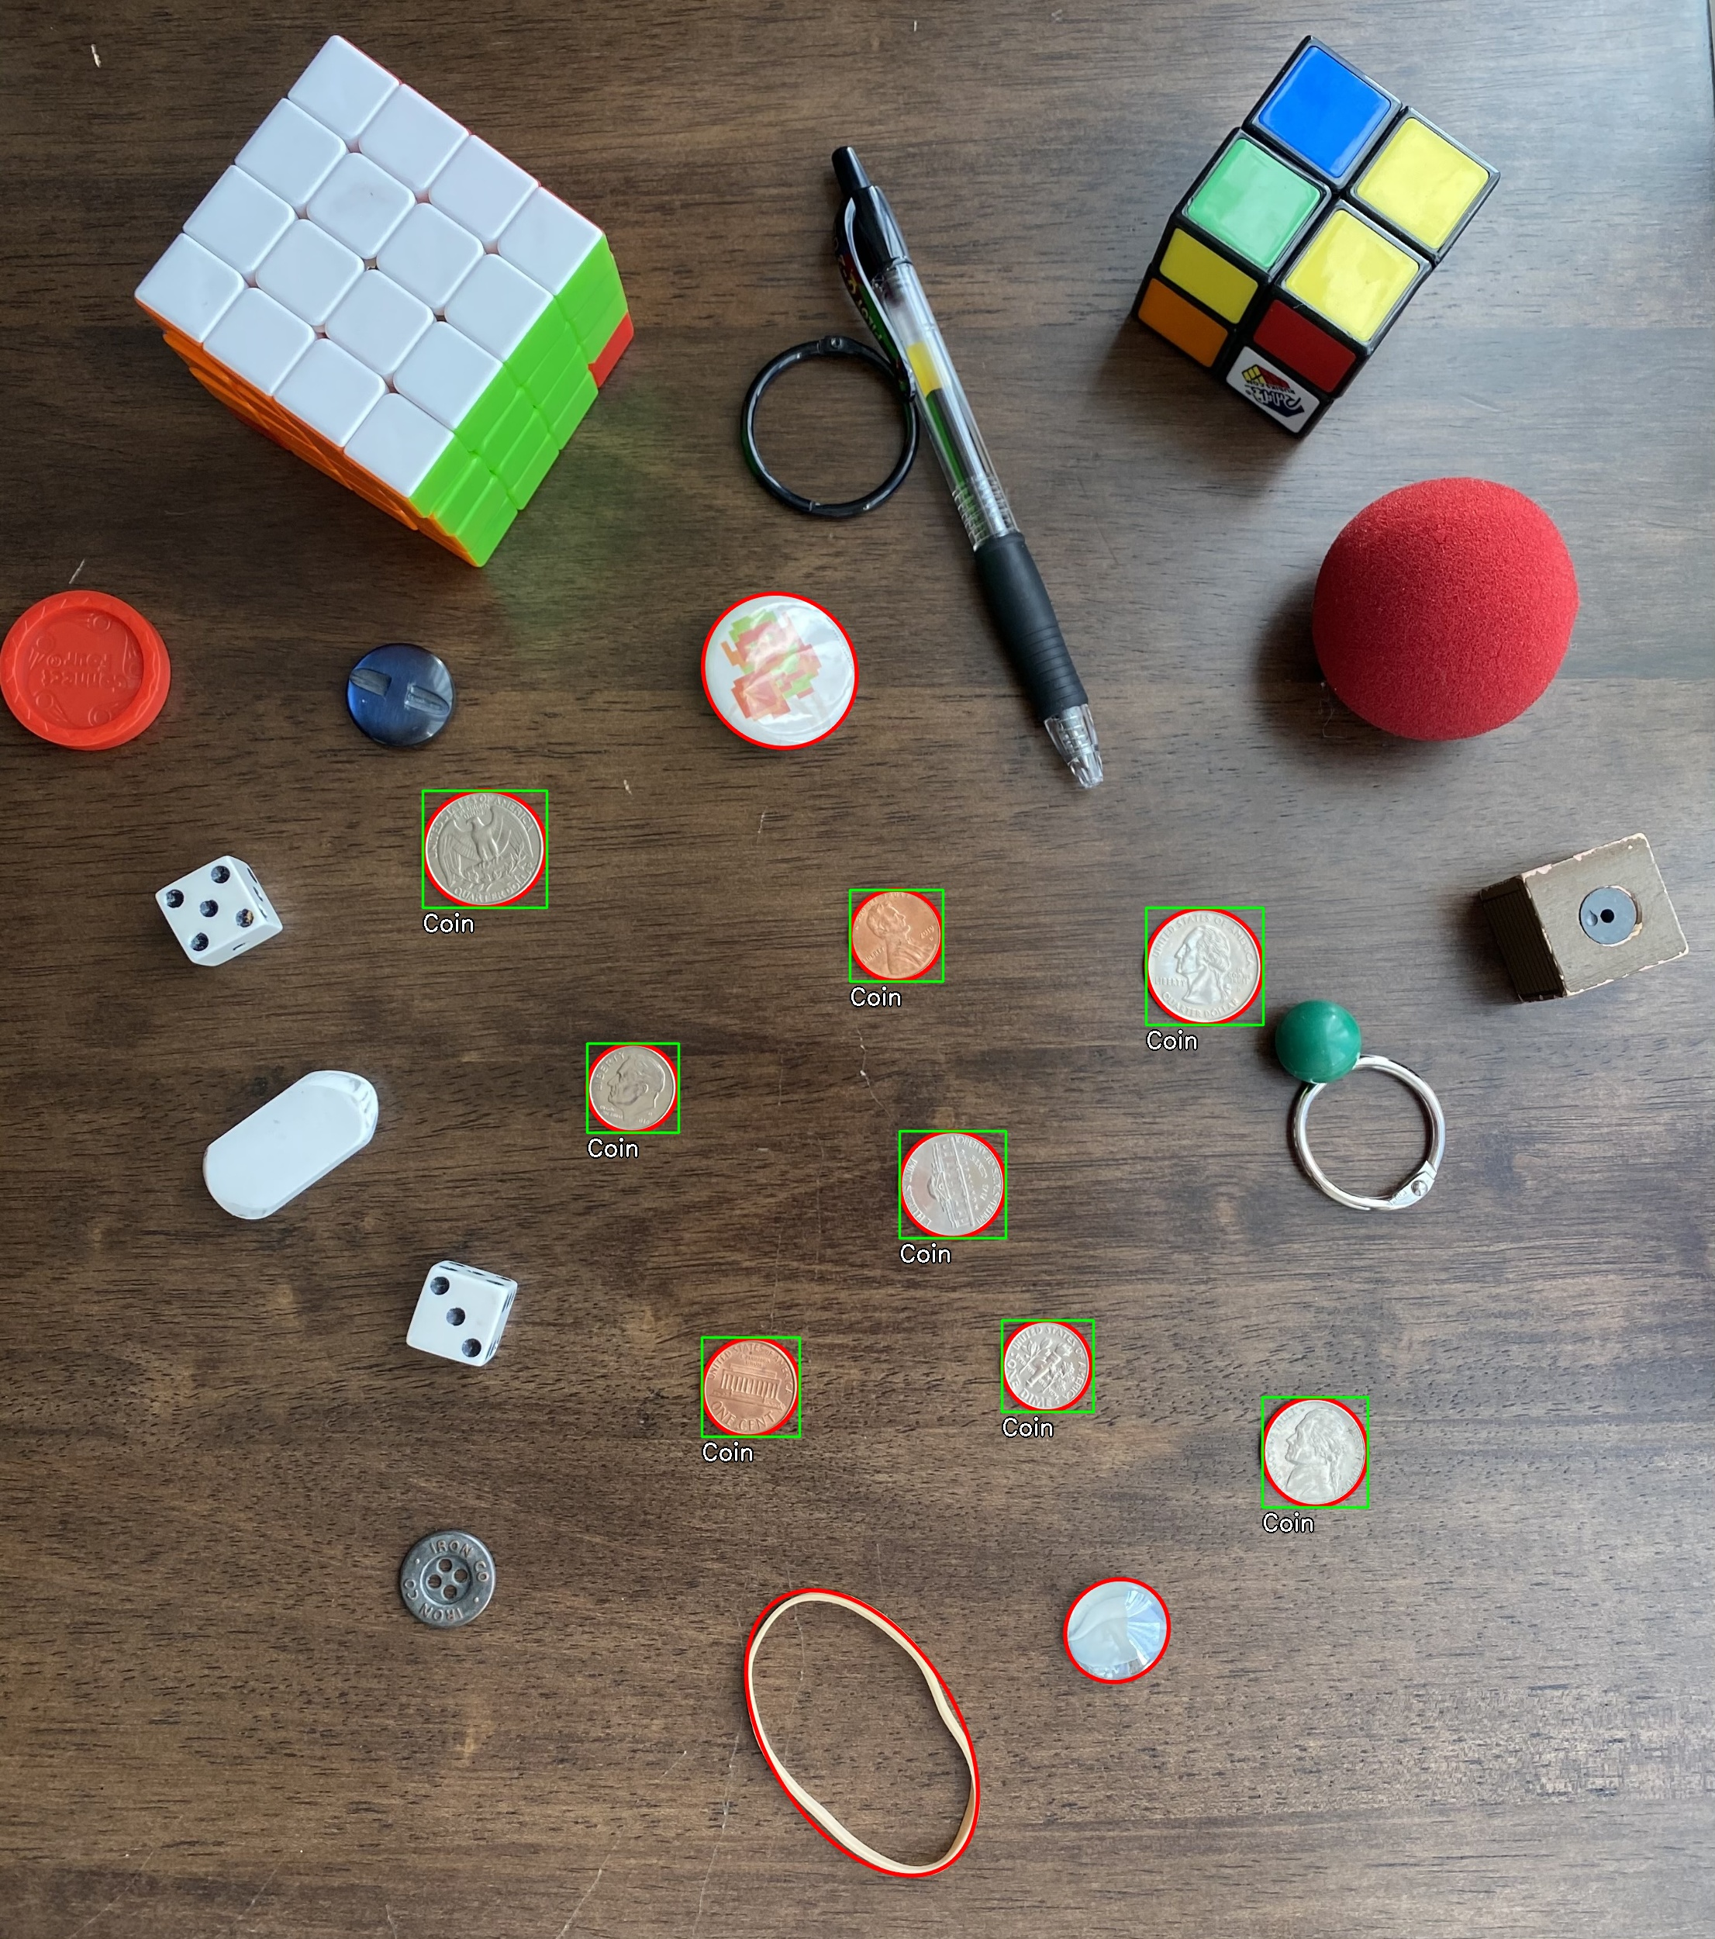
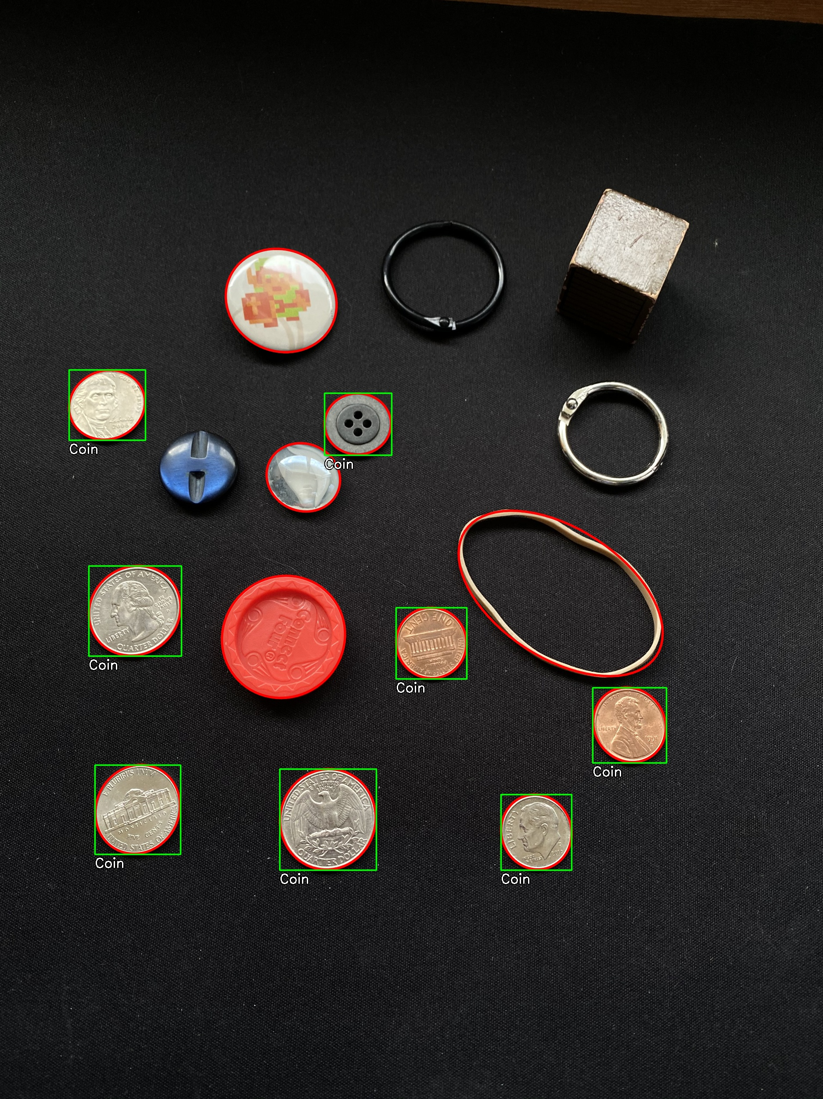
Notes:
Here are a few more examples.
We were also able to filter out the non-circular contours, such as the cubes,
by comparing the area of the contour
with the area of a bounding ellipse
and only keeping close matches.
Again, all the coins were identified correctly.

Slide 30
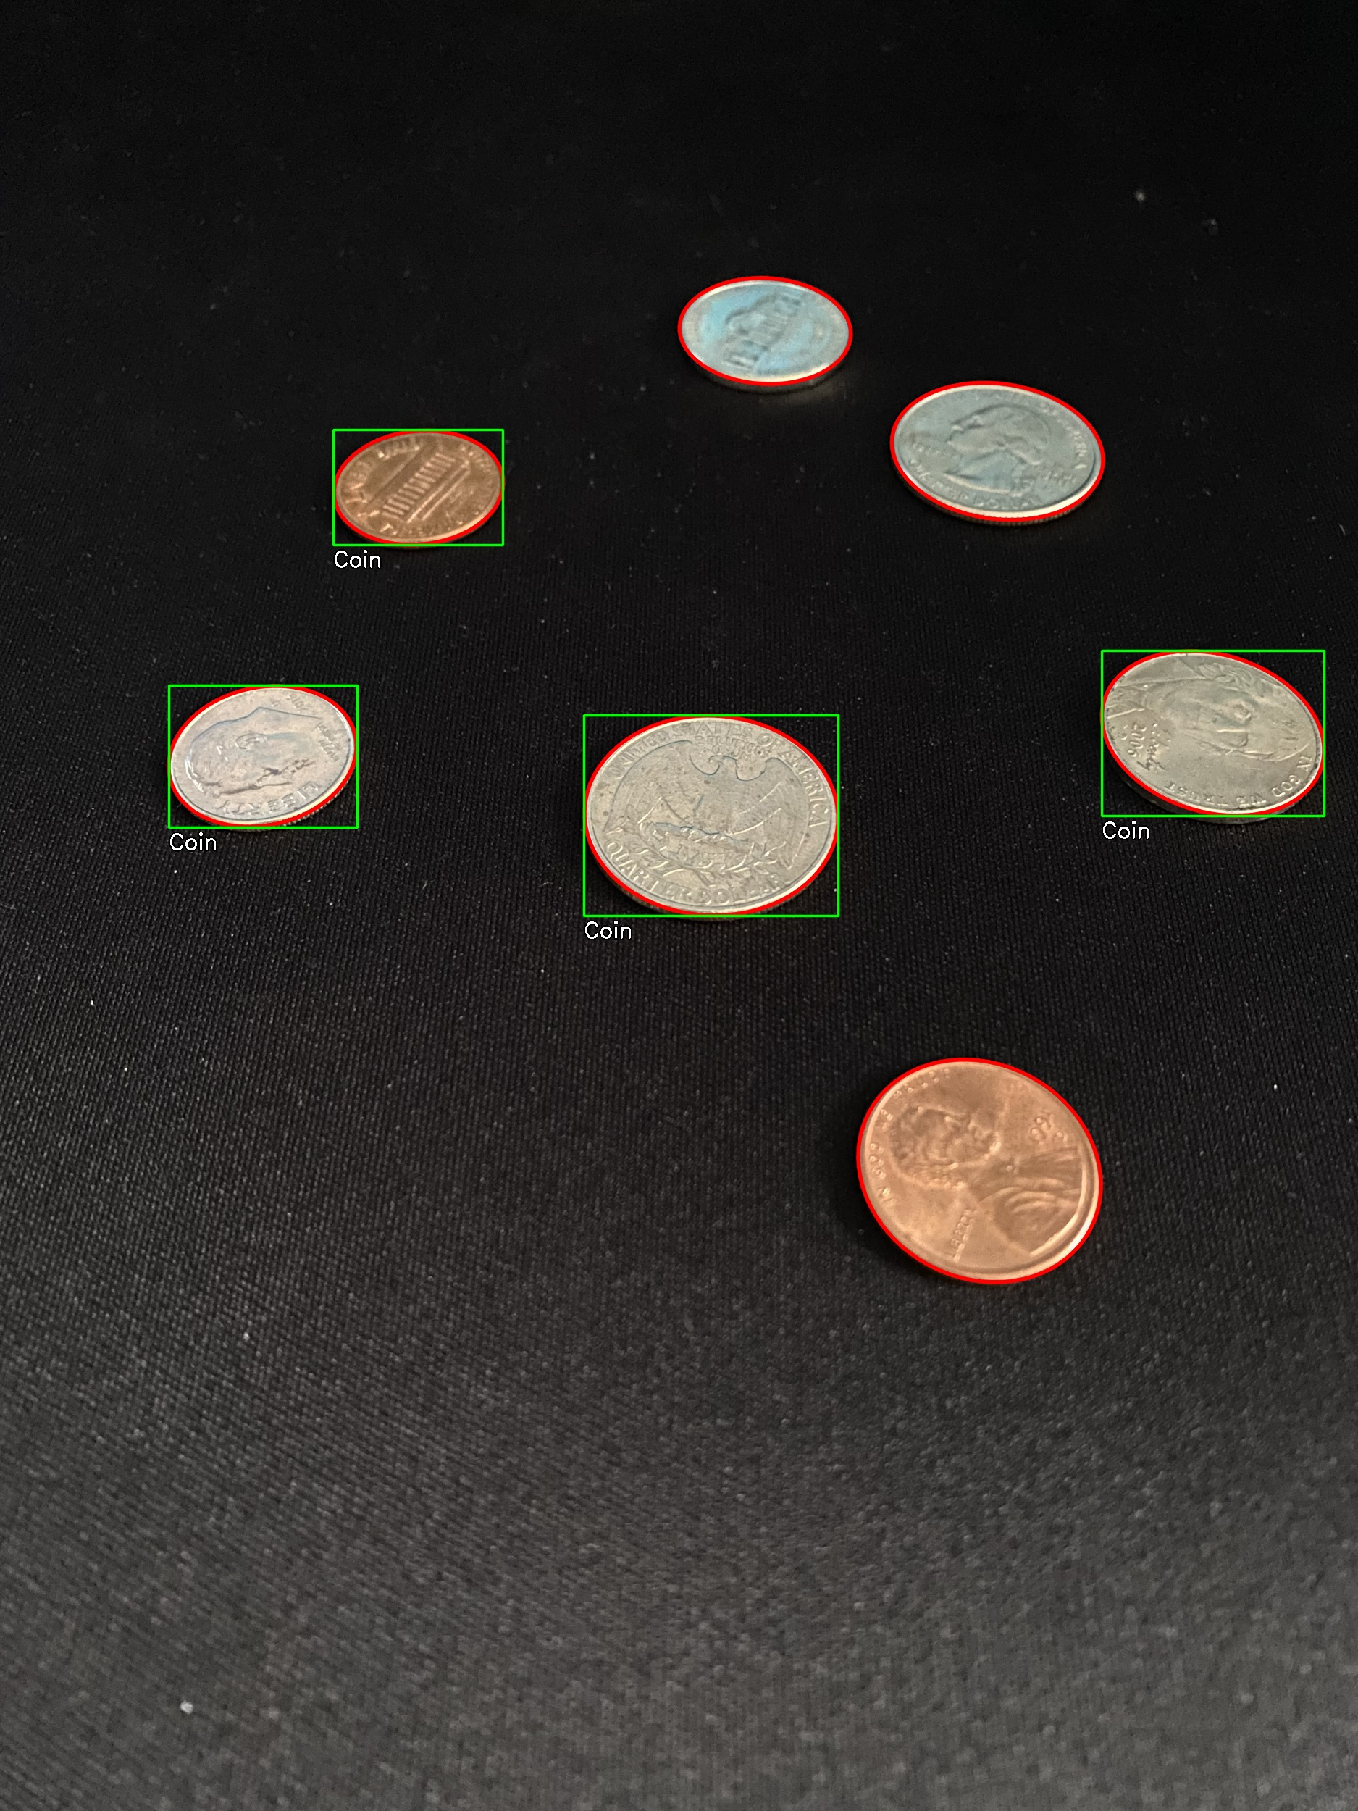

Challenges
Too much Angle
Too much angle + bad lighting
Notes:
Plan to account for these challenges: Shear the template image to the same angle as the patch before rotating it to have a more accurate comparison.

Slide 31
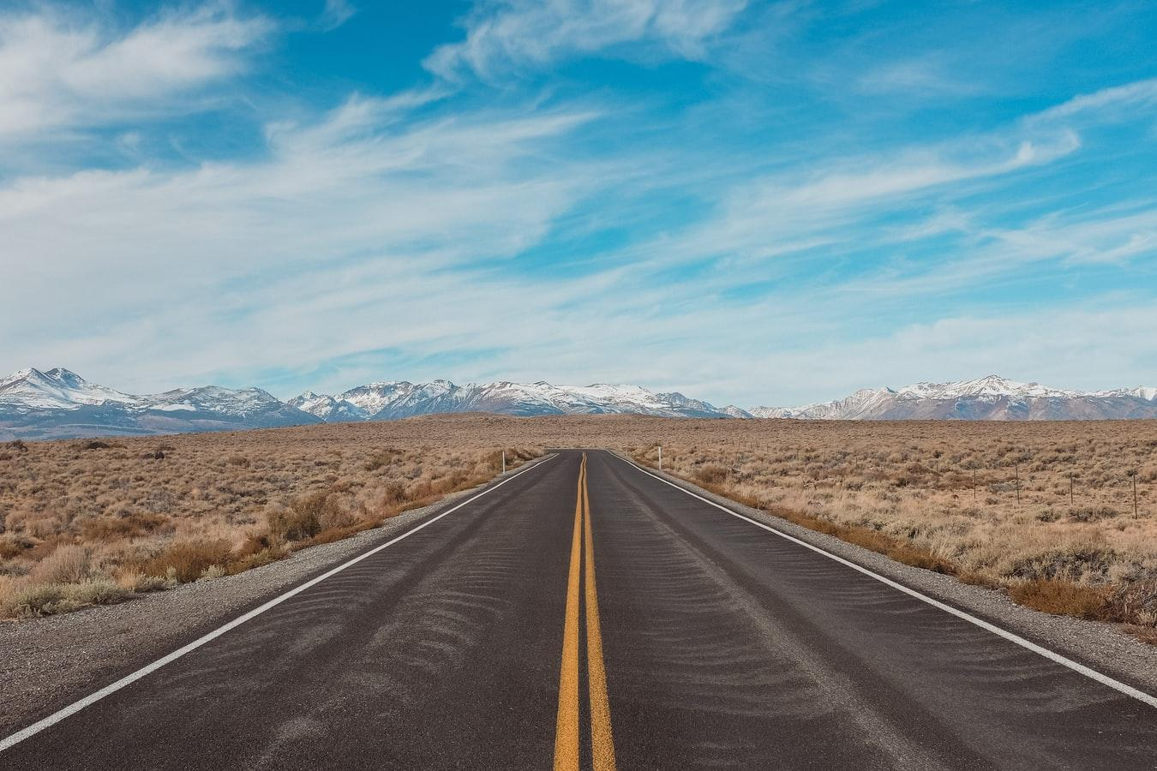

Room for Improvement
Notes:
Here is an example image at our attempts to determine coin type.

Slide 32
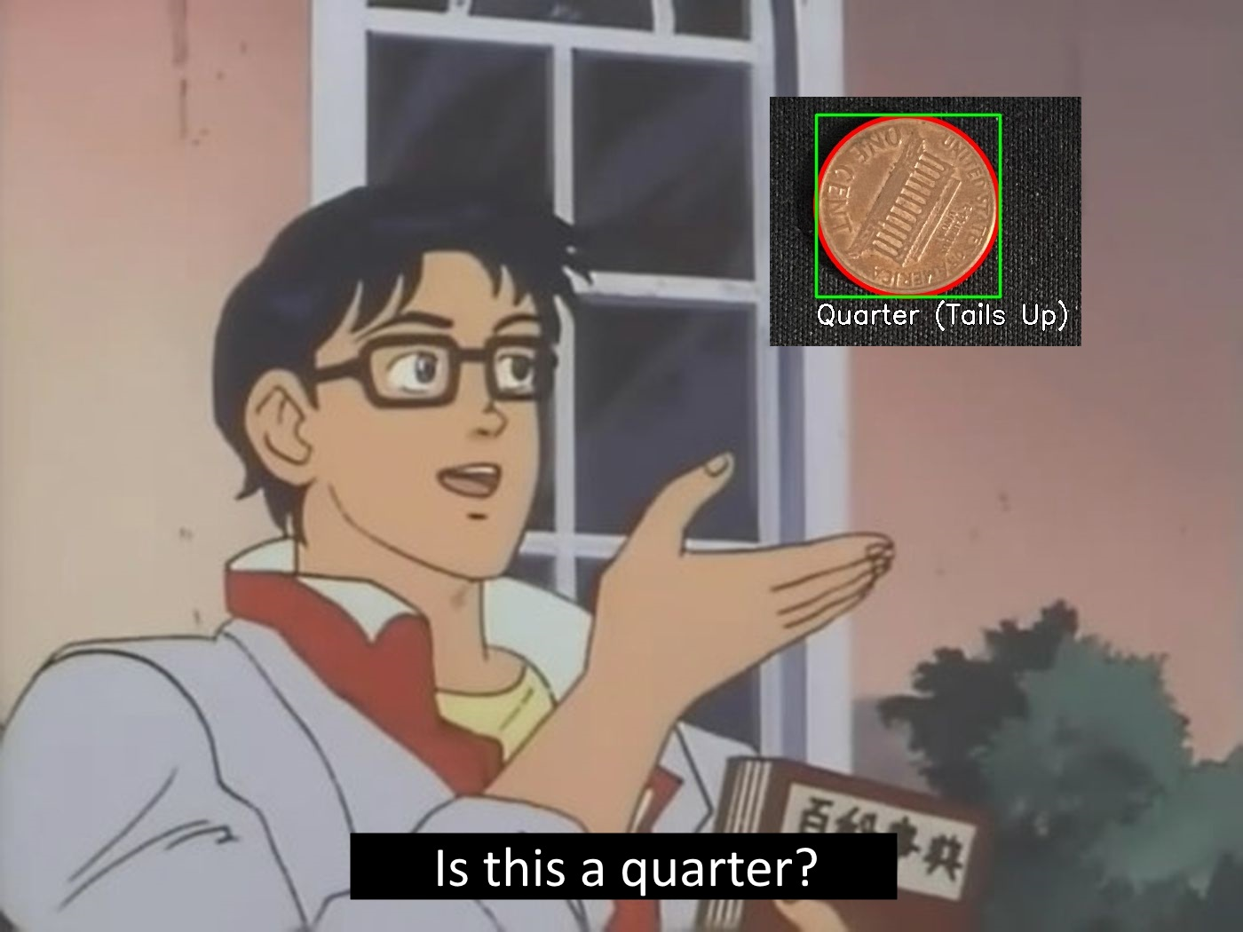
Moving Forwards
Type-determination is not very smart…
Neither is detection of heads/tails orientation.
Notes:
Everything matches to a tails-up quarter.
This makes sense because a tails-up quarter has the most edges. Since we are counting the number of matched edges as a score and considering the highest number of matches the best match, it always matches to the coin with the most edges.

Slide 33
Moving Forward
Using this next week ahead of us, we will…
Improve our template matching to make better guesses at coin-type.
In 90-degree shots, compare the relative size of detected coins to one another to determine coin type.
Compare number of edges between detected coins to determine heads-up or tails-up
Notes:
We’ll have to try to get it to match with something different than tails-up quarter every time.

Slide 34
Moving Forward
Fine-tune color matching to allow for better recognition of coin-type.
Improve upon our ability to recognize coins in a tilted image.
Notes:
At this point, we’re not sure color is reliable enough to use. Nonetheless, it’s worth a bit more effort to make it work.

Slide 35
That’s all! Thanks!
Notes:
That concludes our project for now!
We’ll try to use this next week ahead of us to work out the flaws and get it in better condition.
Thanks for listening!

